Slide 1
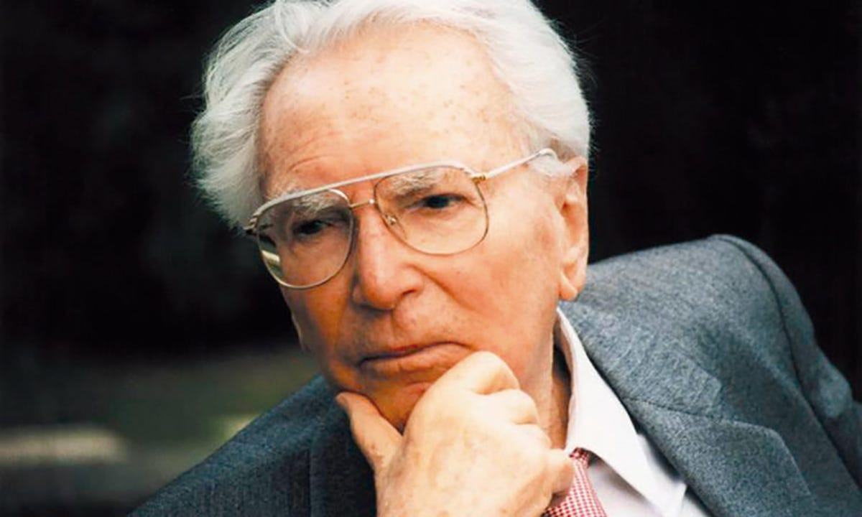
Existentialism
Dr. A. John Balaiah
Head, Department of Counselling Psychology

Slide 2
Existentialism
Viktor Frankle (1905)
1942-1945 - Prisoner in Nazi concentration Camps ( Parents, brother, wife and children died)
Experiences in a constructive way # dampen the spirits
1940s – Ellenora
MD & Ph D – university of Vienna
Book- Man’s search for Meaning
Love – greatest goal and Salvation through love
Everything could be taken away but not
“ Last of human freedoms – to choose one’s attitudes in any given set of situations, to choose one’s own way” –
Searching for meaning and purpose
Discover through actions and deeds by experiencing a value like love or achievements through work) and by suffering
Many Theorists

Slide 3
Rollo May (1909-1994)
Lived in Ohio and then to Michigan
Struggles in life with two failed marriages
Greek civilization and later joined Alfred Adler
During his Ph D- Tuberculosis
Book- The Meaning of Anxiety ( 1950)
Book – Love and will
Questions Western attitude towards Sex and marriage
Greatest personal influence was- German Philosopher Paul Tillich ( Courage to be , 1952)
Psychotherapy is - Problems of being not problem solving
Sex & intimacy, growing old , facing death
Real challenge is – Face life when one is alone
Individualism should have a social interest ( Alfred Adler)
Too much concern about self and little about the society
If individuals are grounded on higher values then therapists will be out of business

Slide 4
ET
Philosophical approach
No techniques / No specific models
Existential ideas
Rejects deterministic view of human nature ( CPA & Radical behaviourism)
CPS- Freedom restricted by unconscious forces
RB- Freedom restricted by sociocultural conditioning
ET- Freedom to choose what to make of the circumstances
We are free and responsible for our choices and actions
Who is the author of life? VVV
Premise – We are not the victims of the circumstances
ET- Not to cure people like the medical model
Clients are viewed as sick of life / awkward at living
Process of searching for value and meaning in life

Slide 5
ET
Many streams ( Not founded by any one person)
Facing loneliness & anxiety
Victor Frankle: Followed Freud. Fond of quoting Nietzsch: “ He who has a why to live for can bear with almost any how”
Logotherapy- Therapy through meaning
Means to love but often has no menaing to live for
Existential Vaccum
May: Existence : A new dimension in psychiatry and psychology

Slide 6
ET
James Bugental and Irving Yalom
Bugental- Art of the Psychotherapist (1987)
Therapy is entering deep in to the subjective world
Therapists should be in touch with phenomenological world
Examine, how they have answered their existential questions and challenge them to revise their answers

Slide 7
ET
Yalom
Death , Freedom, existential isolation and meaninglessness
Existential Psychotherapy ( 1980)
Many theories employ existential themes
Four ultimate concerns , which constitute the heart of psychodynamics, have enormous relevance to clinical work

Slide 8
Key concepts
What makes men and women human beings
Current focus on clients who feel alone in this world and face anxiety in this world
Significance is never fixed
Continually recreate ourselves through our projects
Continually question ourselves, others and world
Who am I ?
Who have I been?
Whom can I become?
Where am I going?

Slide 9
Basic human dimensions – six propositions
1. The capacity for self awareness
We are finite , potential to take act or not to act
We choose and we create our destiny
Meaning is not bestowed on us, we work for it
Existential anxiety is part of our freedom and it makes us responsible
Subject to loneliness, guilt, emptiness and meaninglessness
We are basically alone, yet we have an opportunity to relate to other beings
( Walking on the hall way- with many doors)
Prisoners of the past

Slide 10
2. Freedom and Responsibility
(I am brought up this way.
Makes excuses Jean –Paul Sartre
Inathenticity of not accepting personal responsibility
Bad Faith-I am this way. I brought in a poor background. Alcoholic family
To exist is never to choose excuses
People are condemned to freedom. Calls for commitment
We experience guilt when we are not responsible
Being free and being human goes hand in hand
VF- Statue of Liberty on the East Coast be supplemented with the responsibility on the West Coast
Freedom is bound by certain conditions)
No blame game
Teach clients of their freedom & Responsibility otherwise they will neurotically dependent on the therapist
Helping them to change from old patterns to New patterns

Slide 11
3. Striving for Identity and Relationship to others
The courage to be: Core self, no self and no substance ( Greatest fears of the clients)
Aloneness: Separation- we alone can give a sense of meaning to us. Relationship with self and then relationship with others
It is a paradox – Alone and Related
Relatedness: We want to be significant in other’s world
Relationship with on fulfillment not on deprivation Rather than searching within ourselves, we search outside. Strangers to ourselves.
Struggling with identity- Identity developed in childhood. We are trapped in the doing mode to avoid the experience of being

Slide 12
4. The search for meaning
Do you like the direction of your life?
Why am I here?
What do I want from life?
Problem of discarding old values- Substitutions/ Replacements ( Boat without a rudder)
Create a value system based on a way of being in consistent with the way of living
Meaninglessness: Is there any point of struggling since I am a mortal
Page in a book quickly turned . Existential vacuum
Therapy takes up meaningful way of living
Existential guilt – Sense of incompleteness # neurotic guilt
Creating New Meaning: Even in suffering. But meaning is not something that we can directly search for . Like pleasure , meaning must be pursued obliquely
By product of engagement

Slide 13
5.Anxiety as a condition of living
Normal and Neurotic anxiety
Anxiety as a potential source of growth
Used as a motivation – proportionate to the event
Neurotic- out of proportion and it tends to immobilize people
Opening up new choices is an invitation to anxiety
Paradoxes of existence such as life and death, success and failure , freedom and necessity and certainty and doubt
Existential anxiety is like viewing life as an adventure (Soren Kierkegaard)
Too little anxiety , motivation for change is low
Building new life style will be met with anxiety , but eventually anxiety will diminish with newer ways of being

Slide 14
6.Awareness of death and nonbeing
Does not view death negatively but as a basic human condition gives significance to living
Reality of the future and the inevitability of death
If you think about death, then think the significance of life
When we defend against the reality of death, life becomes insipid and meaningless.
So complete the project when you are mortals
Death is the source of zest for life and creativity. Death and life are independent, though physical death destroys , the idea of death saves us ( Yalom)
Psychotherapy: Death has a major role to play. Transformation from stale mode to authentic mode
Without fear of nonbeing, clients can develop a healthy awareness of death and to evaluate how well they are living
Those who fear death, also fear life as though they are saying, “ I fear death because I have never really lived”

Slide 15
Initial Assessment (Ruth)
Good candidate for ET.
Question the meaning of life and to challenge some of her comfortable, but dull patterns. Developmental Crisis
Children leaving the home. Choices are open but anxiety increases.
How well am I living my life? (Wife and mother).

Slide 16
Strengths
Willingness to ask questions. Religion, Motherhood, motivation to change her life
Therapeutic Relationship. Not abandoning even if she makes mistakes. Even if displeased. Not her father. Therapy is not something I do. No passive client. Dialogue in the deepest and the most genuine sense. Partners travelling. Neither knows where we are ending. Subjective viewpoint and let her know of my personal reactions. Who am I? Who have I been? Who can I become? Where am I going?
Deempahasis techniques

Slide 17
Goals of therapy
Establishing a therapeutic relationship
Identifying the problem and setting the therapeutic goal
Analyzing the existential source of the symptoms
Reconstruction of the self
Manifesting and authentic existence
Not to cure of disorders but to bring them out of victim stance.
Rigid way of existence. Existence is limited
To discover the freedom that she possesses
Help her to take steps towards liberation
Responsible & Meaningful existence

Slide 18
Therapeutic Process
Doesn’t rely on techniques. However borrow techniques
Certain themes that are part of human conditions
Fully presence and reaction right now
In what ways are you living as fully as you might? How are you living a limited existence
To what degree are you living by your own choices as opposed to living a life outline by others?
What choices have you made so far and how far these choices affected you?
What are the choices you have now that create anxiety in you?
What are some of the changes that you want to make and what is preventing them? ( Ruth’s Case)
Opening the closed doors. Deterministic shackles that have kept someone psychologically bound
Carving out her life. Look for alternatives for making her visions become real

Slide 19
Therapeutic process ( Ruth)
Midlife crisis. Values that have little meaning, feelings of emptiness, fears about making wrong choices. Restructuring. Anxiety. Dissatisfactions.
Finding new values: Religion (once married –married for life-Does not accept that position). Changes might lead to divorce or have positive impact on your relationship? Walk away from the marriage but I am scared who I would be without John (Husband)? John picked me when parents and church let off? Talking about reactions in the family but how do you want to be different?

Slide 20
Therapeutic process ( Ruth)
Dealing with Anxiety: Whenever she thinks of changing. Being Stuck. Waking up at midnight, in cold sweats, trouble breathing, heart pounding. Worry of dying. All is not well. Anxiety as a negative thing. May be a possibility of a new starting point of her life. Increased awareness of her freedom and her sense of responsibility.
Exploring the meaning of death: What I want from life before I die? Die as a sinner, go to hell for eternity. Think and talk about areas that not lived fully in life? Dead- Fun, Sexuality? Examine the quality of life? Not allowed her spirit to die> Old values have died not found new ones. Deadness as a precondition for her rebirth. Experiencing and Expressing- how she wants to live?

Slide 21
Outcome of Therapy
No absolute answers outside of herself
Open discussions
How we experience each other in therapy is a new experience
Being direct with the therapist
Turn the other cheek-How often?
Occasions that put her needs last and choose to be the giver to other. Specific situations that she fails to be assertive?
Self observation process. Not to eliminate therapy but to help understand what it means. Anxiety is a signal. How does she deal? Creation of new identity
She has a choice to make in spite of uncertainties and accompanying anxiety. Still have to act by making choices and then living with the consequences. She has a choice to continue therapy or terminate

